Slide 1
Chapter 4 Medium Access Control
Prepared By:
Prof. Vishal A. Polara
Assistant Professor
Information Technology Department
Birla Vishvakarma Mahavidyalaya Engineering College

Slide 2
Outline
Multiple Access Protocols
Ethernet
Data Link Layer Switching : Bridges, local Internetworking, Spanning tree bridges, Remote Bridge, Repeaters, Hub, Switches, routers, Gateway, Virtual LANs.

Slide 3
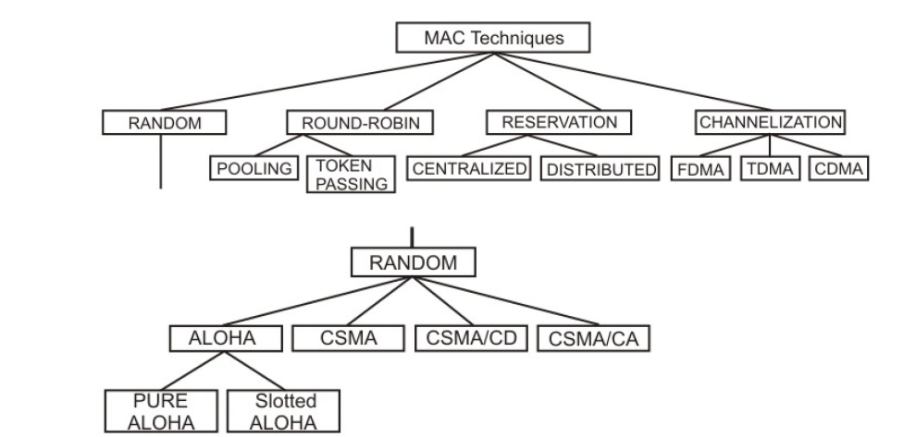
Mac technique

Slide 4
4.1. Random technique of MAC
ALOHA
Pure ALOHA
Slotted ALOHA
Carrier Sense Multiple Access (CSMA)
CSMA/CD
CSMA/CA

Slide 5
4.1.1Pure Aloha
It is content base approach means when data is available not frequently.
The original aloha is called pure aloha.
In this technique each station sends a frame whenever it has a frame to send.
But there is only one channel so there may be a chance of collision between frames from different stations.
Pure aloha protocol relies on acknowledgement from receiver, it expect acknowledgement from receiver.
First method is time out in which station send frame after some time .In pure aloha when the time out period passes each station waits a random amount of time before resending its frame. It helps avoid more collisions.
Another method is retransmission of maximum frame after that station goes down and try after some time.

Slide 6
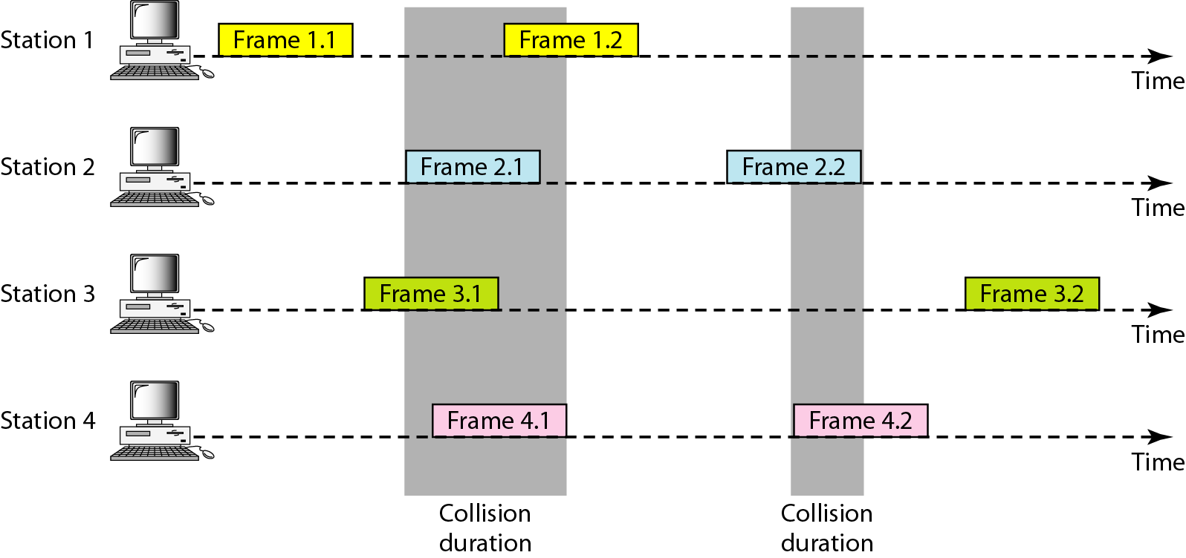
Figure Frames in a pure ALOHA network

Slide 7
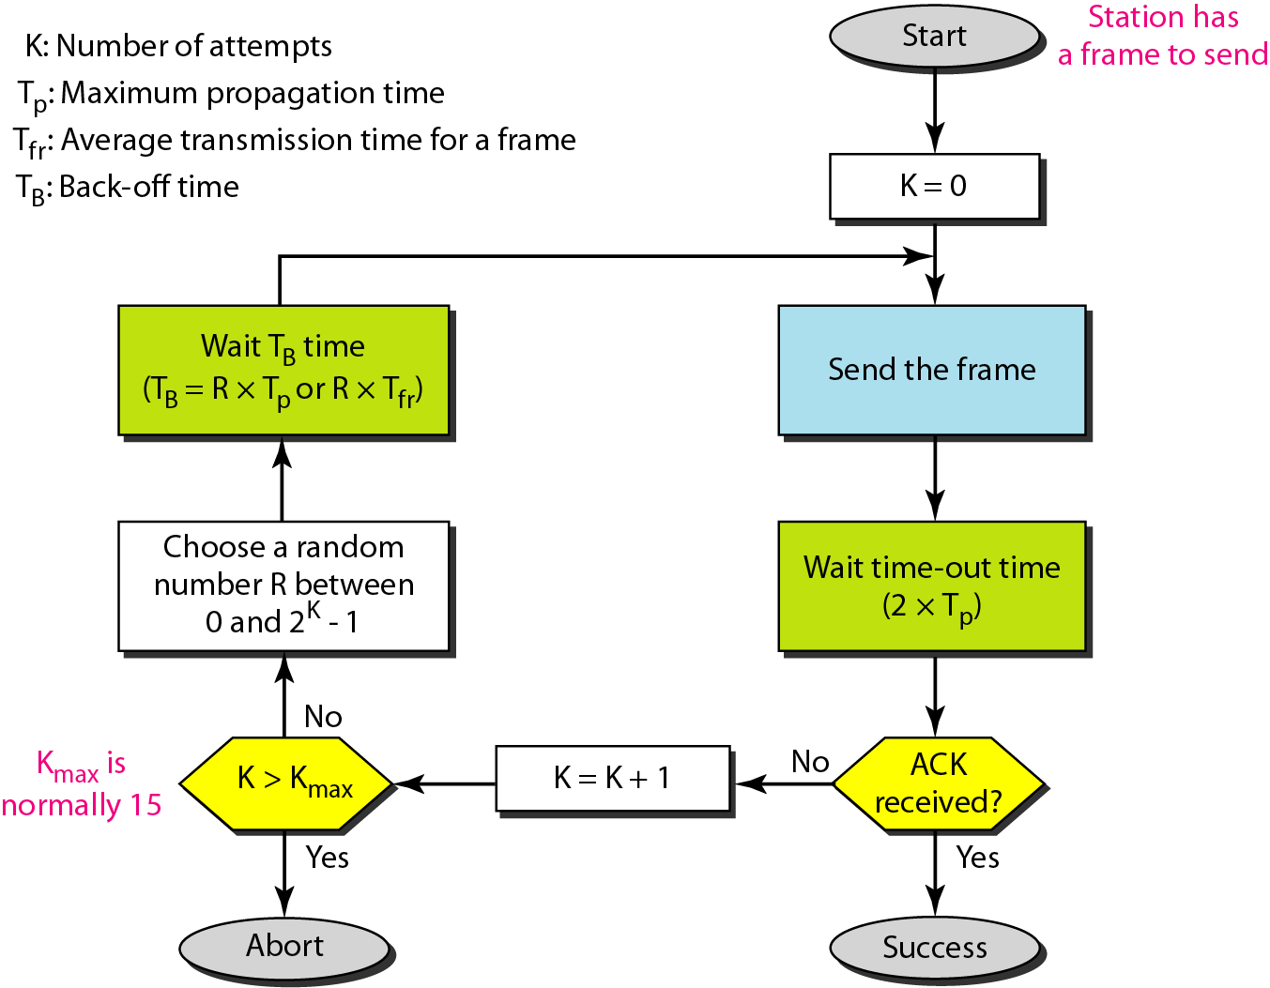
Figure Procedure for pure ALOHA protocol

Slide 8
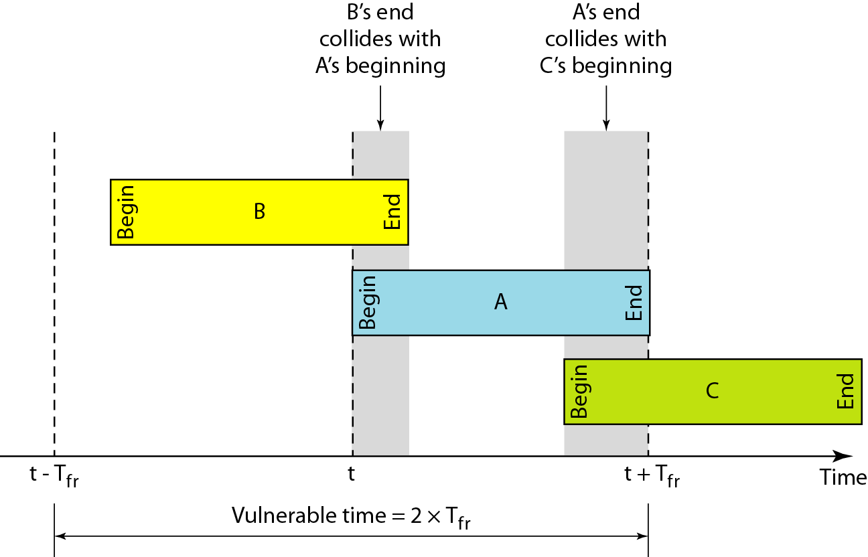
Figure Vulnerable time for pure ALOHA protocol

Slide 9
4.1.2 Slotted Aloha
Slotted aloha was invented to improve the efficiency of the pure aloha.
In slotted aloha we divide the time into slots of Ts and force the station to send only at the beginning of the time slot.
If station misses this beginning moment it must have to wait until beginning of the next time slot.
Still there is a possibility of collision if two station uses same time slot to transmit the frame but here vulnerable time slot is one half that of pure aloha.

Slide 10
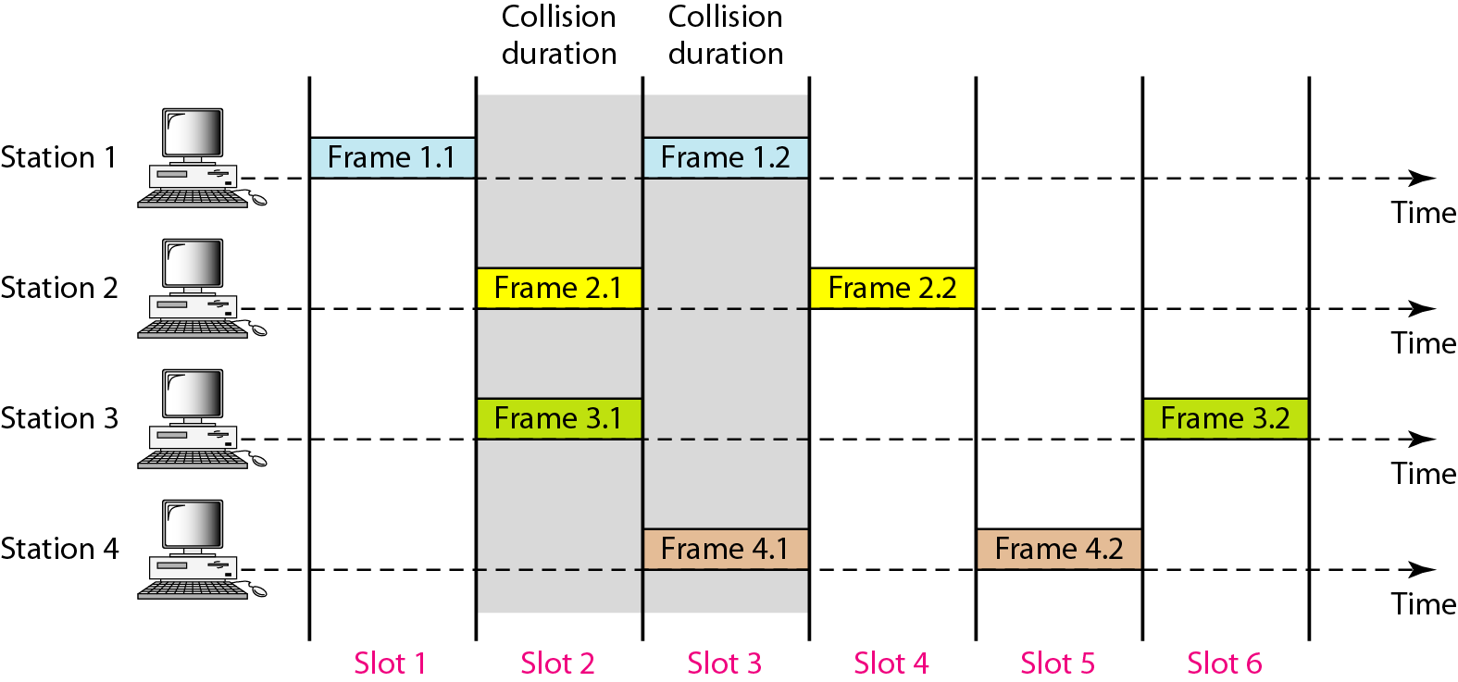
Figure Frames in a slotted ALOHA network

Slide 11
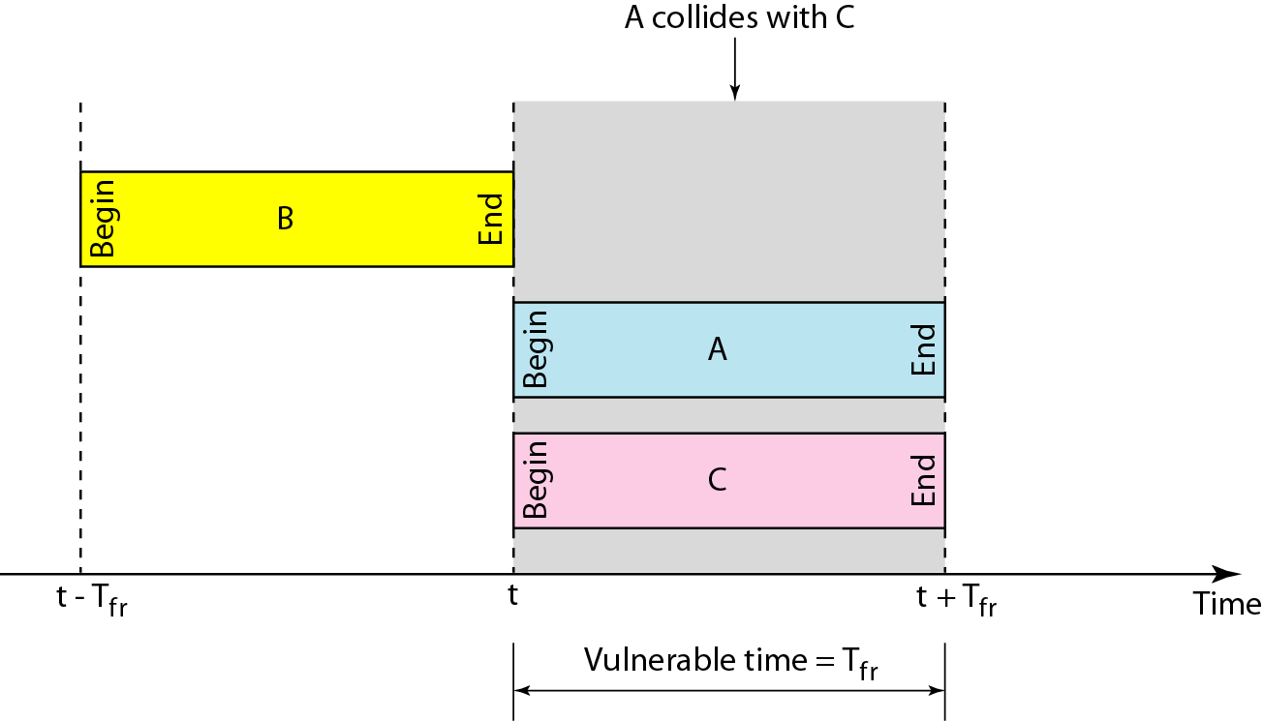
Figure Vulnerable time for slotted ALOHA protocol

Slide 12
4.1.3 Carrier Sense Multiple Access(CSMA)
The chance of collision can be reduced if station sense the medium is busy or free.
CSMA requires that each station first listen to the medium before sending.
It work on principal “sense before transmits” or “listen before talk”.
It can reduce the possibility of collision but it cannot eliminate.
Collision happens because of propagation delay. Because station sense medium idle because the first bit sent by another station has not yet been received.

Slide 13
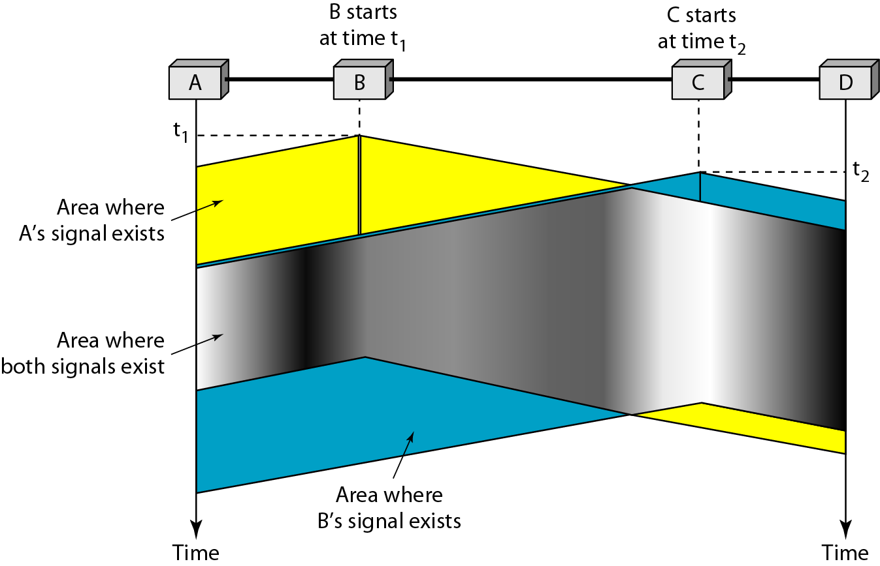
Figure Space/time model of the collision in CSMA

Slide 14
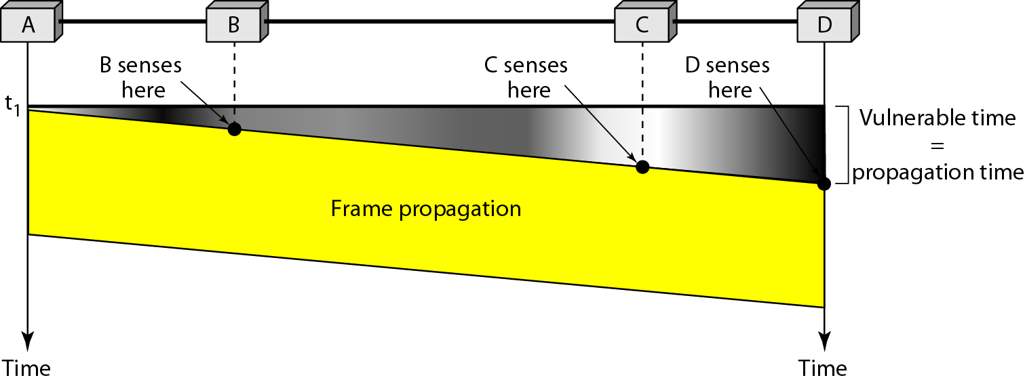
Figure Vulnerable time in CSMA

Slide 15
Persistent Method.
Slotted aloha was invented to improve the efficiency of the pure aloha.
In slotted aloha we divide the time into slots of Ts and force the station to send only at the beginning of the time slot.
If station misses this beginning moment it must have to wait until beginning of the next time slot.
Still there is a possibility of collision if two station uses same time slot to transmit the frame but here vulnerable time slot is one half that of pure aloha.

Slide 16
Persistent Method.
1-persistant Method: Station will continuously sense the channel until it find idle.
Non-persistant Method: Station will not continuously sense the channel it will sense the channel and wait for some amount of time then again it will sense the sense till it finds idle channel to transmit.
P-Persistant: it is used if the channel has time slots with a slot duration equal to or greater than the maximum propagation time.
It reduce the chance of collision and improves efficiency.
When station finds the line idle it follows following stages
With probability p the station sends its frame
With probability q=1-p the station waits for the beginning of the next time slot and checks the line again.
If the line is idle it goes to step 1.
If the line is busy, it acts as though a collision has occurred and used the back off procedure

Slide 17
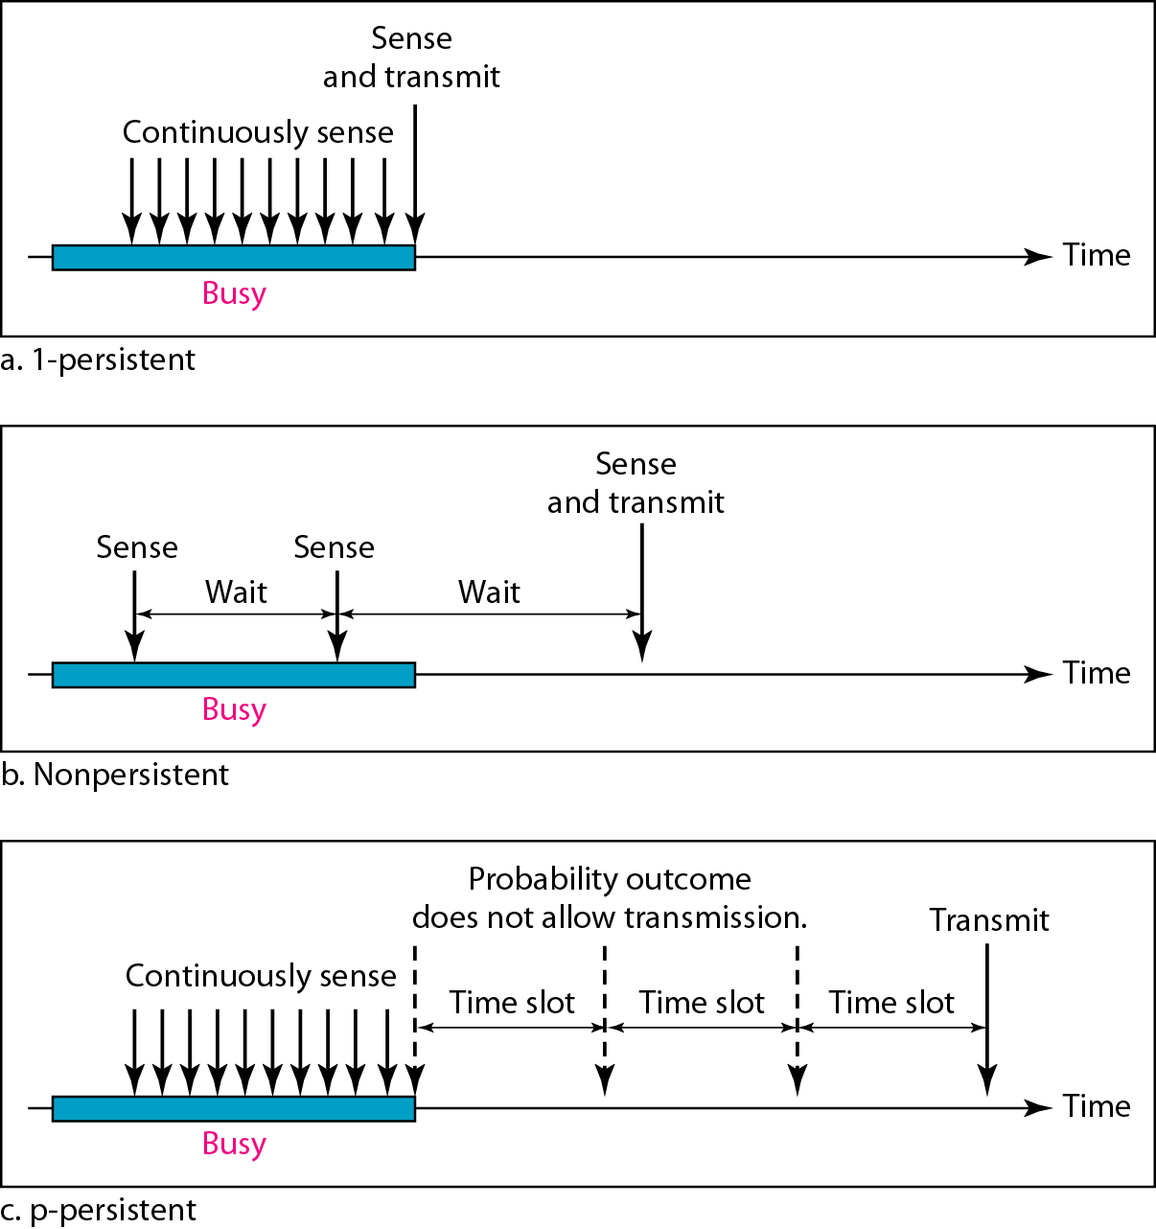
Figure Behavior of three persistence methods

Slide 18
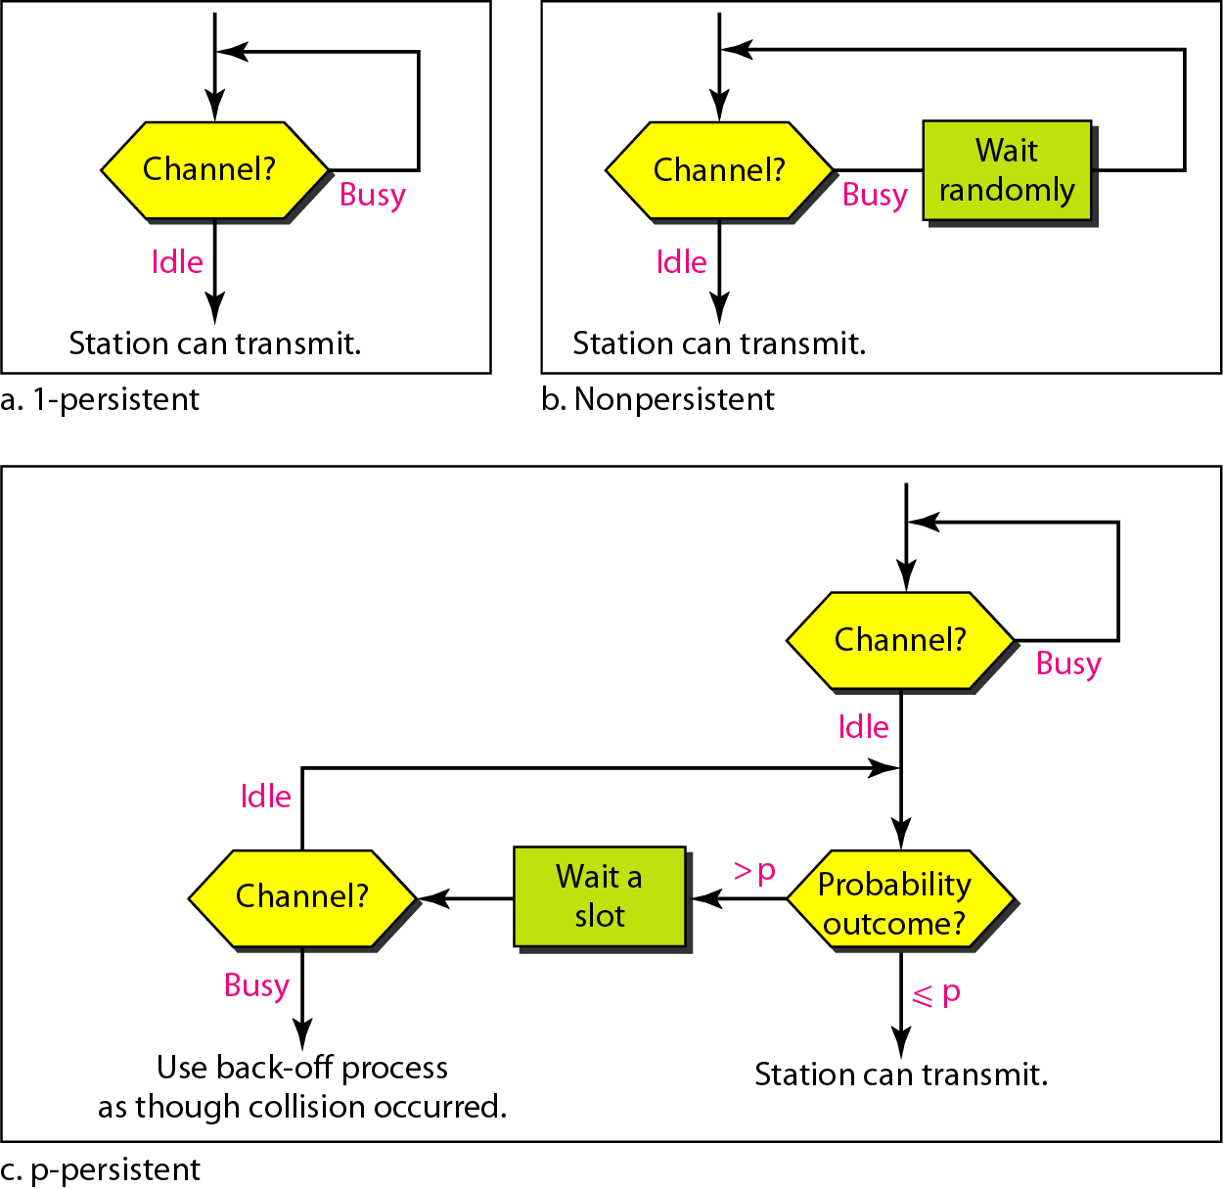
Figure Flow diagram for three persistence methods

Slide 19
4.1.4 CSMA/CD
It is normally used in wired transmission.
In carrier sense multiple access with collision detection technique station will continously sense the channel while transmitting the message, Listen-While-Talk.
(i) If a collision is detected during transmission of a packet, the node immediately ceases transmission and it transmits jamming signal for a brief duration to ensure that all stations know that collision has occurred.
(ii) After transmitting the jamming signal, the node waits for a random amount of time and then transmission is resumed. It will Saves time and bandwidth.
For example two station will be there station A and station B. Station B come to know about collision but station A does not have idea about collision so station one will inform A using jamming signal about collision.

Slide 20
CSMA/CD
It has three type of energy level: ideal, normal and abnormal
Ideal level indicate channel is free.
Normal level indicate someone is transmitting frame.
Abnormal level indicate collision mode of channel.

Slide 21
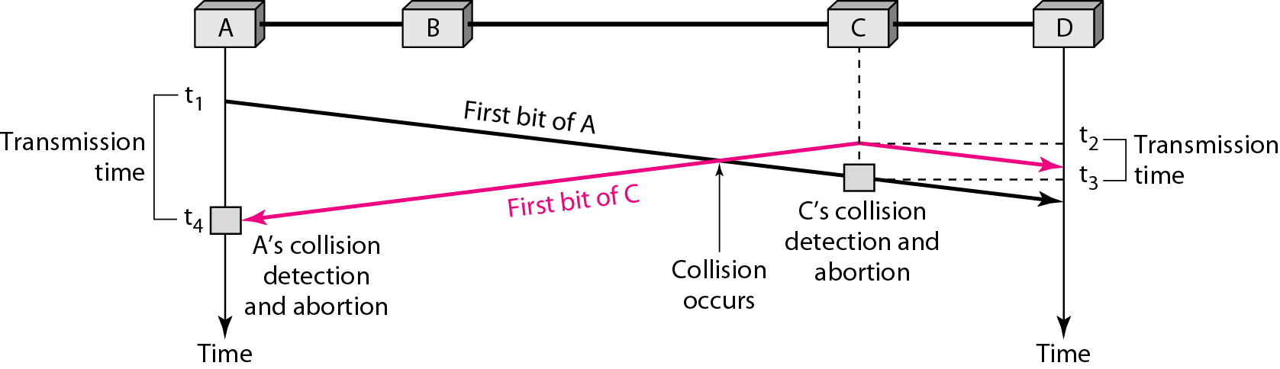
Figure Collision of the first bit in CSMA/CD

Slide 22
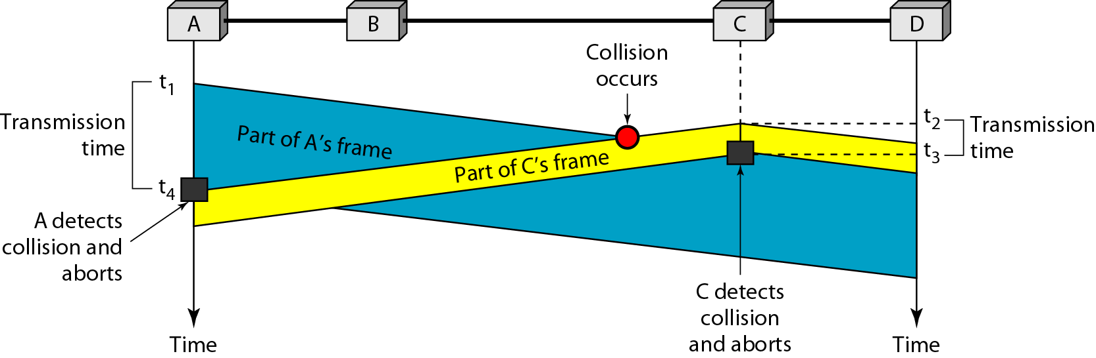
Figure Collision and abortion in CSMA/CD

Slide 23
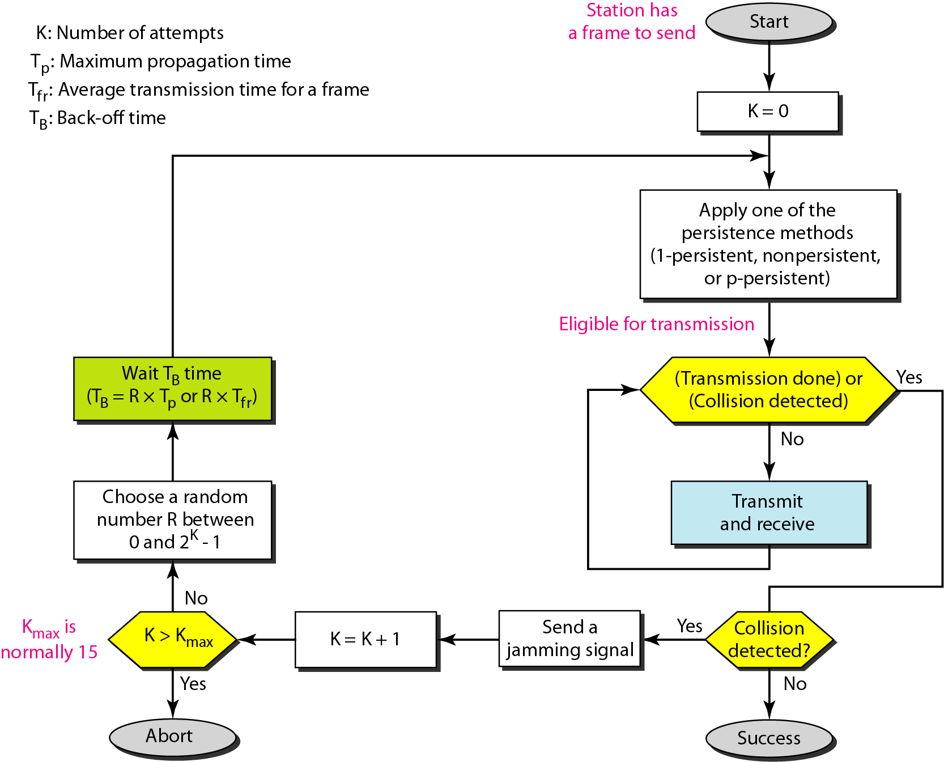
Figure Flow diagram for the CSMA/CD

Slide 24
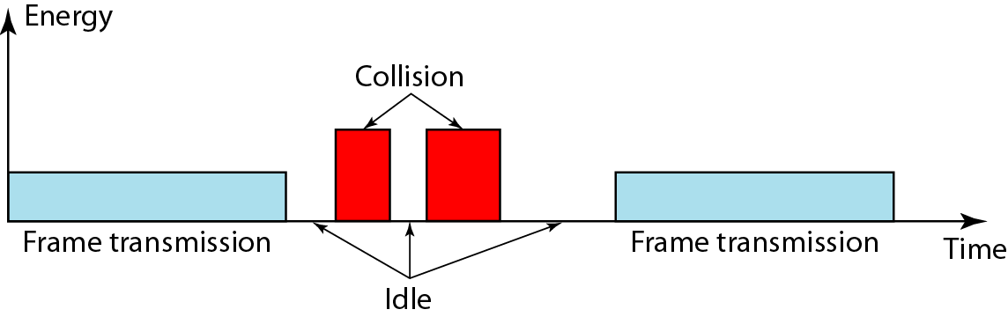
Figure Energy level during transmission, idleness, or collision

Slide 25
4.1.4 CSMA/CA
It is normally used in wireless transmission.
It wireless transmission most of the energy is wasted so it is difficult to detect collision as a result it is normally avoided.
It is avoided using three strategies: the interframe space, the contention window, and acknowledgements.
Interframe space:
It can be avoided by deferring transmission time even if channel is idle. It waits for a period of time called the interframe space.
Station B will wait as per IFS time if station A is sending message so station A get time IFS time to make its message reach station. If after IFS time still channel is idle station can send, but it still needs to wait a time equal to the contention time. Station that is assigned a shorter IFS has a higher priority.

Slide 26
CSMA/CA
Contention window:
It is a time divided into slots. A station that is ready to send chooses a random number of slots as its wait time.
The number of slots in the window changes according to the binary exponential back off strategy.
That means it is set to one slot the first time and then doubles each time the station cannot detect an idle channel after the IFS time.
It will sense channel after each time slot. Here priority to the station is given with the longest waiting time.

Slide 27
CSMA/CA
Acknowledgement:
The positive acknowledgement and the time out timer can help guarantee that the receiver has received the frame.

Slide 28
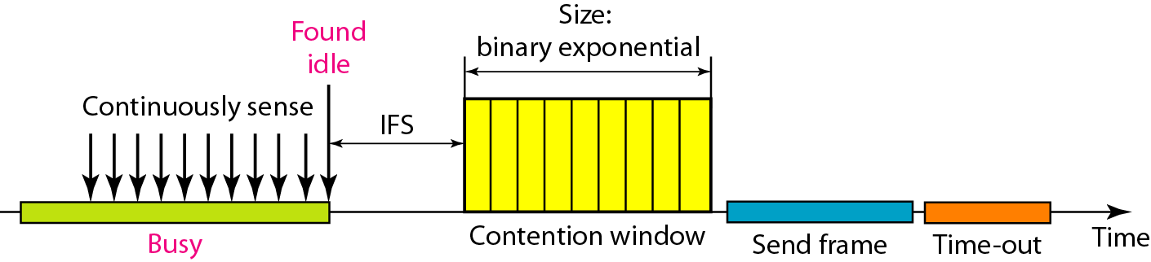
Figure Timing in CSMA/CA

Slide 29
In CSMA/CA, if the station finds the channel busy, it does not restart the timer of the contention window;
it stops the timer and restarts it when the channel becomes idle.

Slide 30
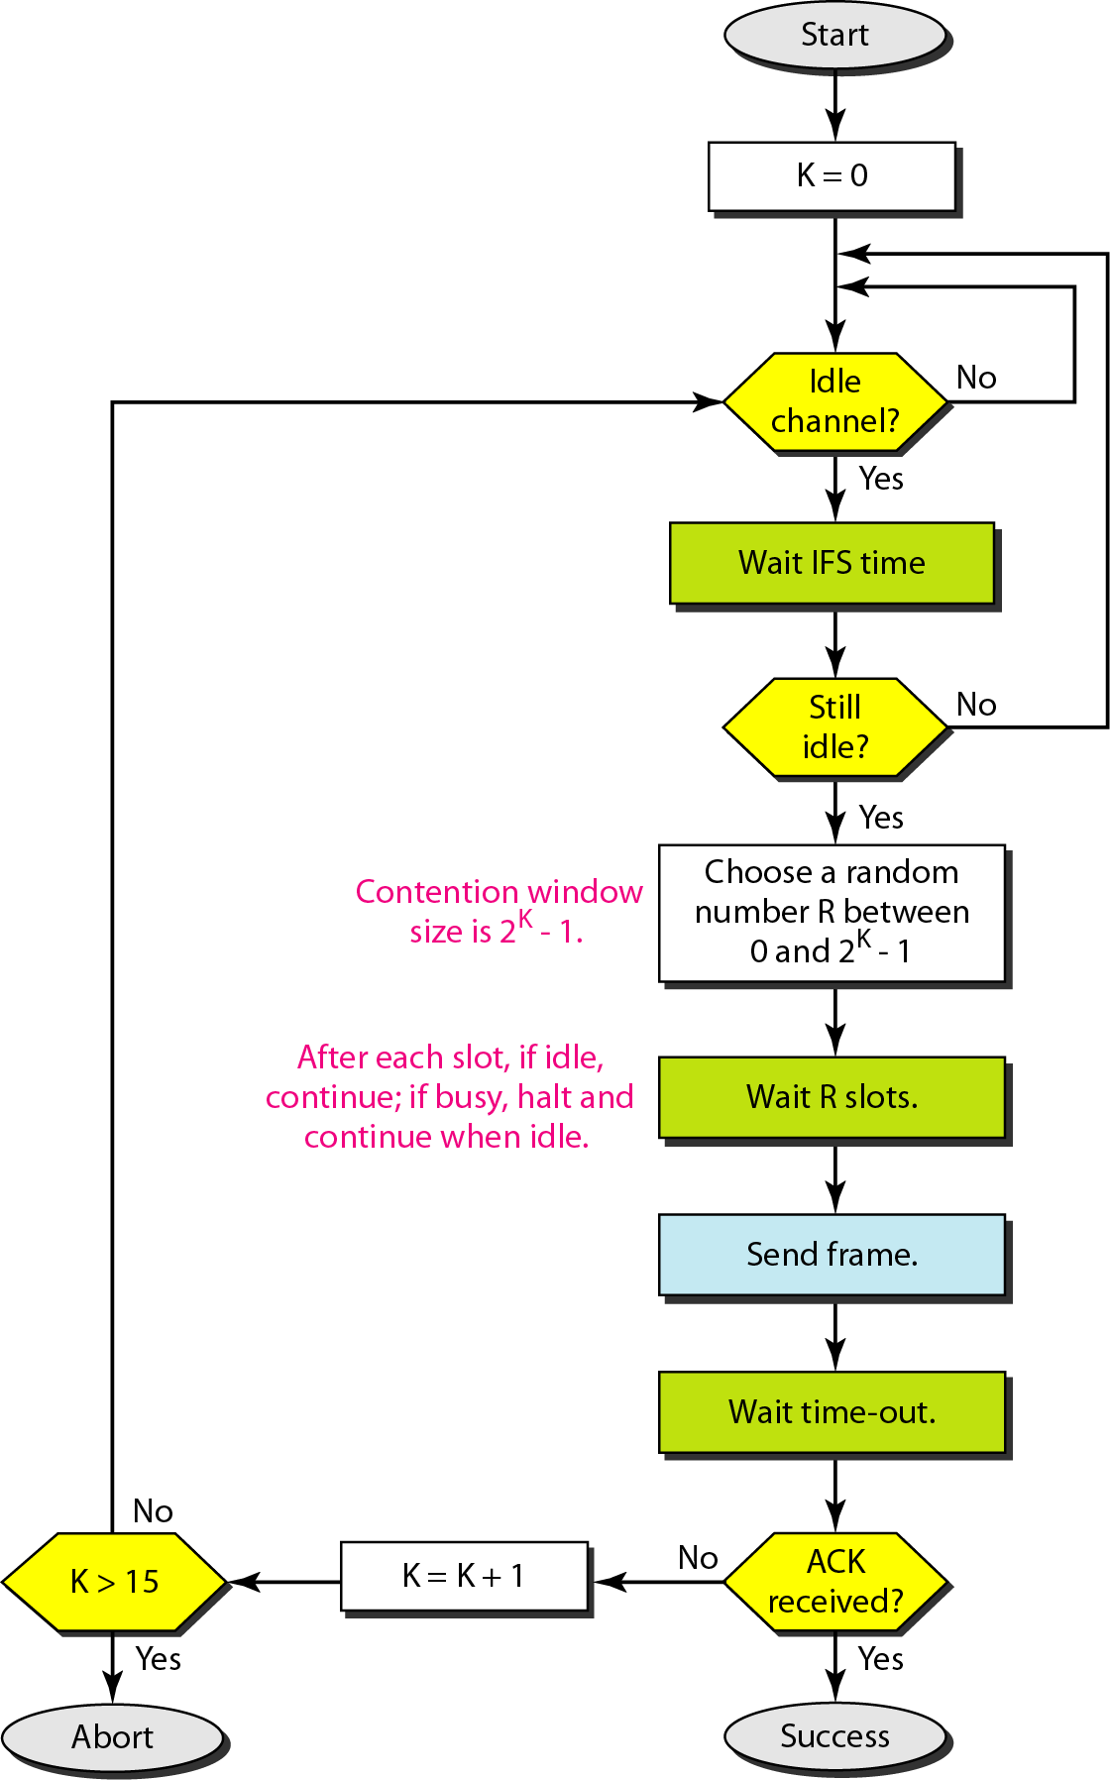
Figure Flow diagram for CSMA/CA

Slide 31
4.2 ROUND ROBIND OR CONTROLLED ACCESS
In controlled access, the stations consult one another to find which station has the right to send. A station cannot send unless it has been authorized by other stations. We discuss three popular controlled-access methods.
Reservation Polling Token Passing

Slide 32
Reservation
In this method a station needs to make a reservation before sending data.
Time is divided into intervals. In each interval a reservation frame precedes the data frames sent in that interval.
If there are N stations in the system there are exactly N reservation minis slots in the reservation frame.
Each minislot belongs to a station. When a station needs to send a data frame it makes a reservation in its own minislot. The station that have made reservations can send their data frames after the reservation frame.

Slide 33
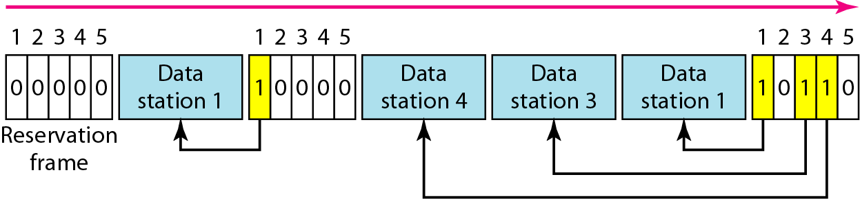
Figure Reservation access method

Slide 34
Polling
In this method two types of stations are there, one is primary station and another is secondary stations.
All the data exchange must be through the primary device even when the ultimate destination is a secondary device.
The primary device controls the link, the secondary devices follow its instructions.
It is up to the primary device to determine which device is allowed to use the channel at a given time.
If a primary wants to receive data ,it asks the secondary's if they have anything to send , this is called poll function. If the primary wants to send data, it tells the secondary to get ready to receive, this is called select function.

Slide 35
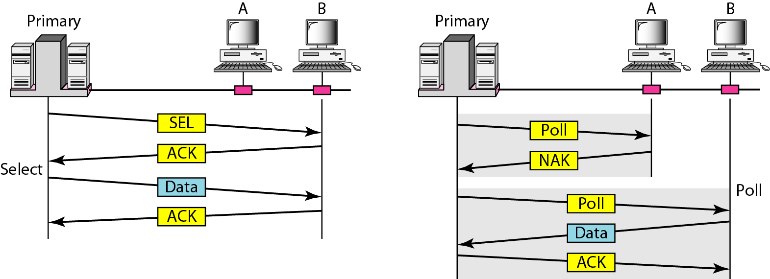
Figure Select and poll functions in polling access method

Slide 36
4.3 Token passing
In the token passing technique all station are organized in a logical ring. There is a predecessor and a successor for each station.
The predecessor is the station which is logically before the station in the ring , the successor is the station which is after the station in the ring.
In this technique one token is circulation in the ring when station has data to send it waits for the token ones token will arrive it check the token if it allow to send then station will send its data. When station has no more data it will release the token on ring.
In this technique token management is needed. There are many disadvantages if token is lost, duplicate token, node leave and rejoin the ring.

Slide 37
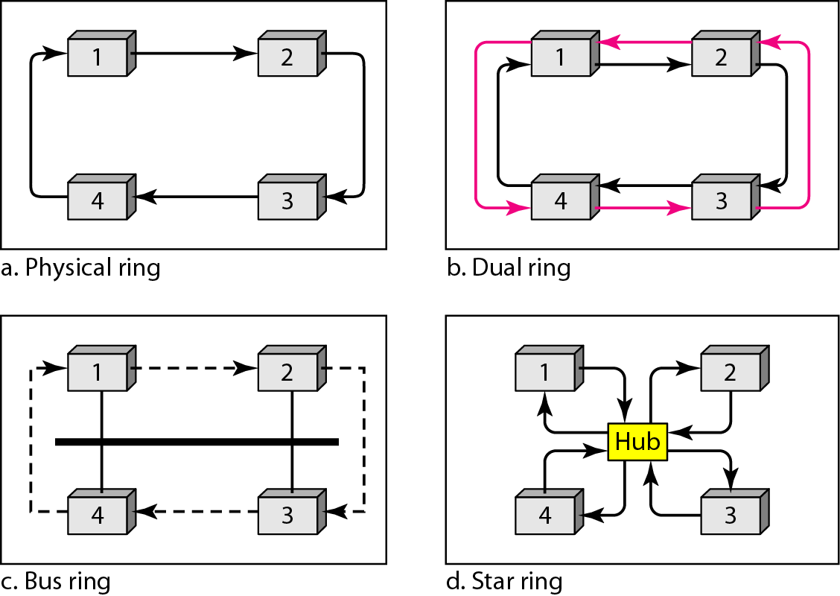
Figure Logical ring and physical topology in token-passing access method

Slide 38
4.4 CHANNELIZATION
Channelization is a multiple-access method in which the available bandwidth of a link is shared in time, frequency, or through code, between different stations. In this section, we discuss three channelization protocols.
Frequency-Division Multiple Access (FDMA) Time-Division Multiple Access (TDMA)
Code-Division Multiple Access (CDMA)

Slide 39
4.3.1 Frequency division multiple access
In frequency division multiple access(FDMA) the available bandwidth is divided into frequency bands. Each stations is allocated a band to send its data.
Each band is reserved for a specific station, and available to that station all the time.
Each station also uses a bandpass filter to confine the transmitter frequencies.
To prevent interference, allocated bands are separated from one another by small guard bands.

Slide 40
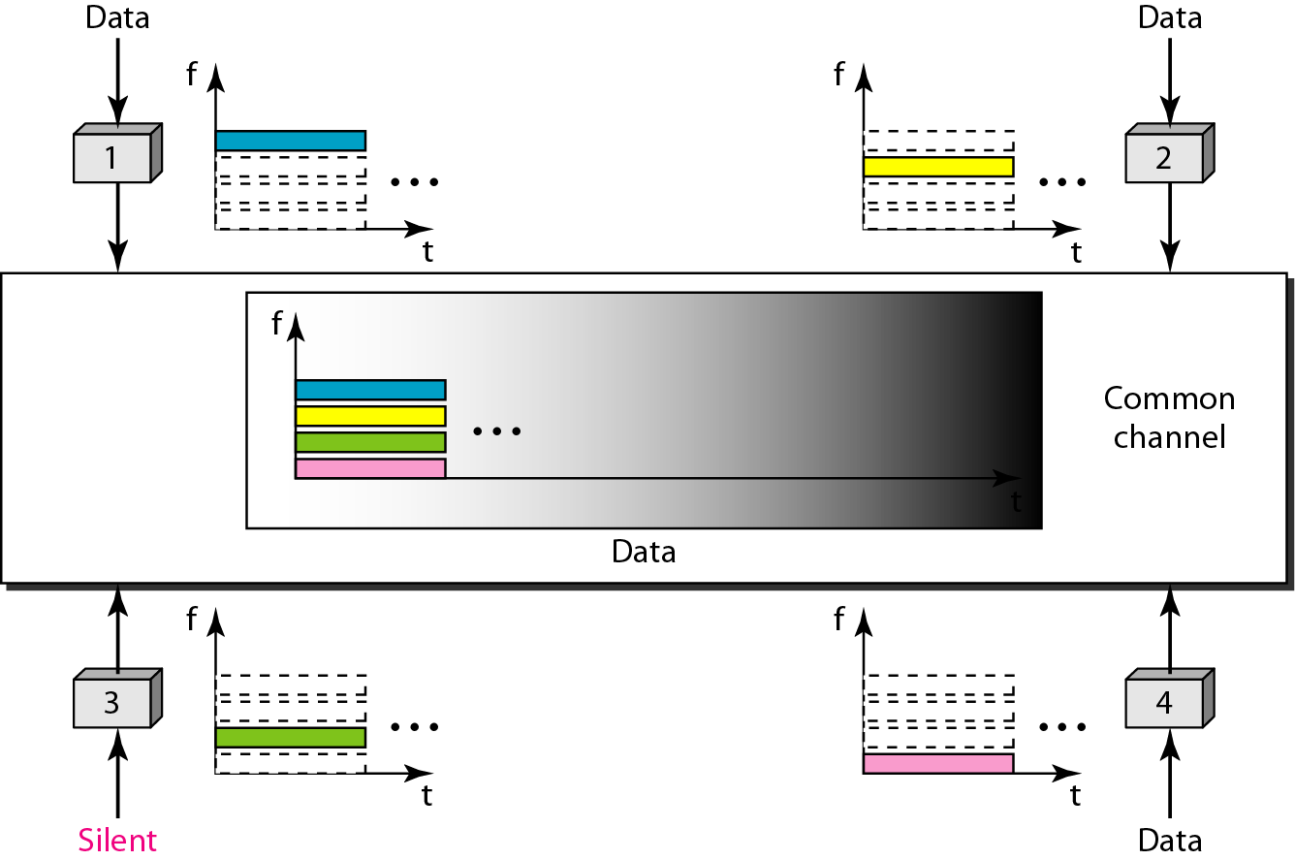
Figure Frequency-division multiple access (FDMA)

Slide 41
4.3.2 Time division multiple access
In time division multiple access the stations share the bandwidth of the channel in time.
each station is allocated a time slot during which it can send data.
Each station transmits its data in is assigned time slot.
The main problem with TDMA lies in achieving synchronization between the different stations.
Each station needs to know the beginning of its slot and the location of its slot.
This may be difficult because of propagation delays introduced in the system if the station are spread over a large area.
Synchronization is normally accomplished by having some synchronization bits at the beginning of each slot.

Slide 42
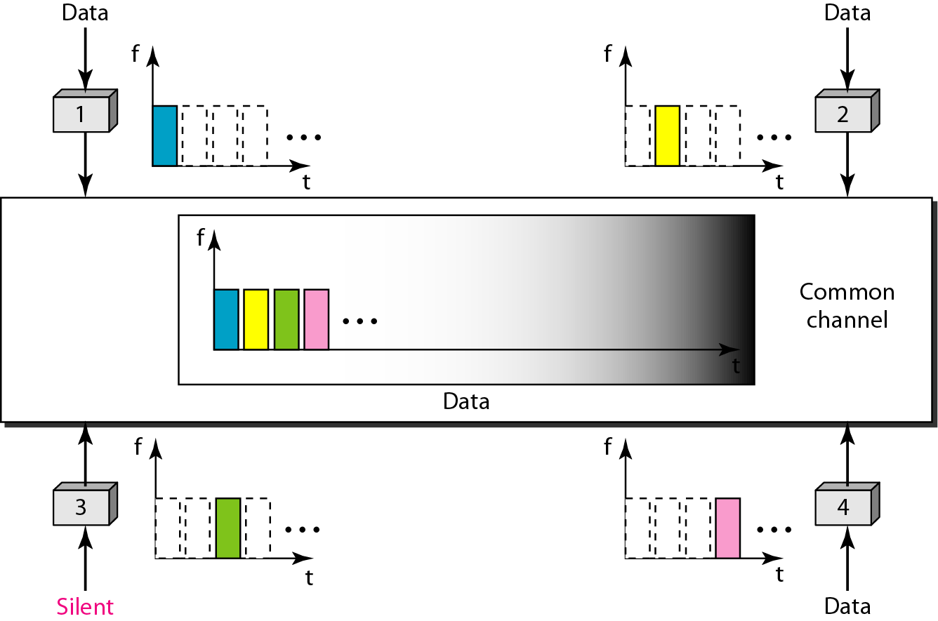
Figure Time-division multiple access (TDMA)

Slide 43
4.3.3 Code division multiple access
In CDMA differs from FDMA because only one channel occupies the entire bandwidth of the link.
It differs from TDMA because all stations can send data simultaneously there is no timesharing.
Here station communicate with different codes.
For example class of student 10 where there is a pair of two students , total five pair all are communicating in different language so there will be no collision.

Slide 44
In CDMA, one channel carries all transmissions simultaneously.

Slide 45
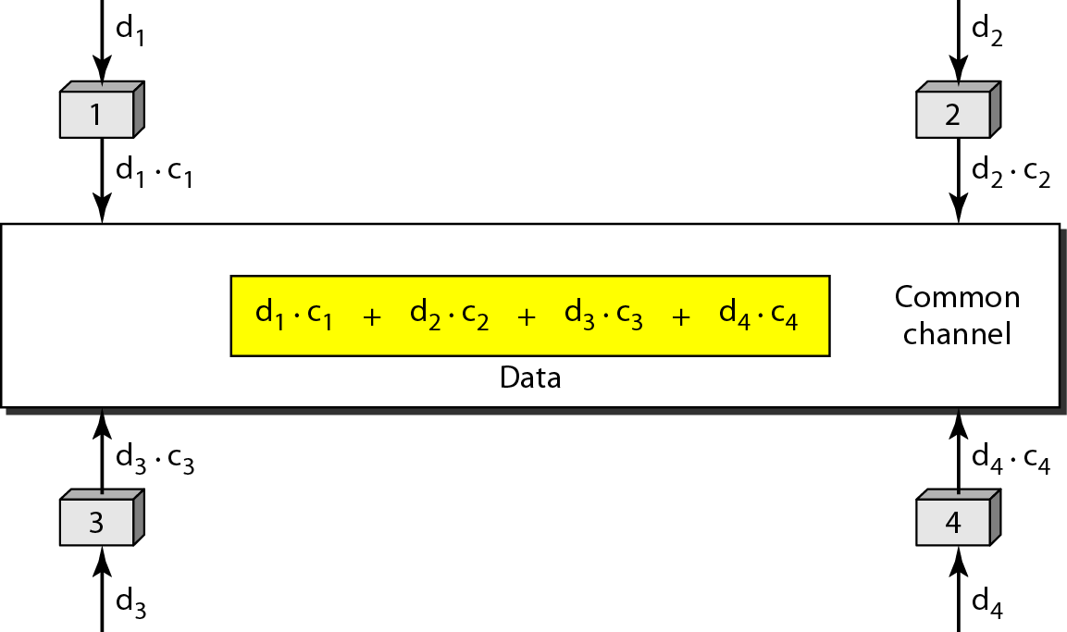
Figure Simple idea of communication with code

Slide 46
4.4 STANDARD ETHERNET
The original Ethernet was created in 1976 at Xerox’s Palo Alto Research Center (PARC). Since then, it has gone through four generations. We briefly discuss the Standard (or traditional) Ethernet in this section.

Slide 47
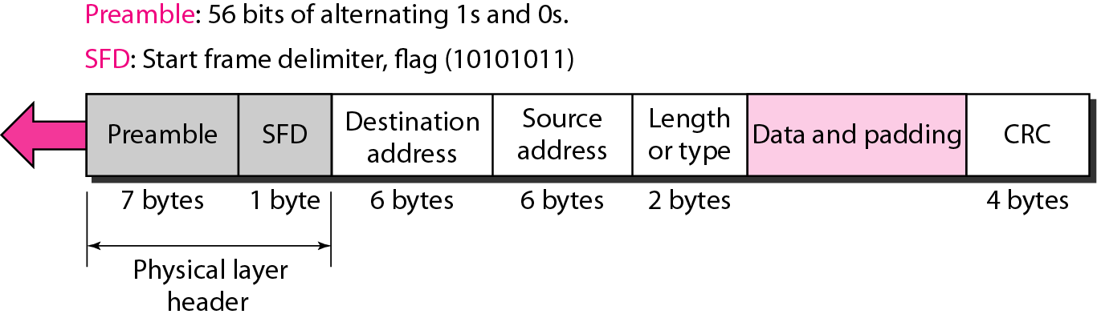
Figure 802.3 MAC frame / Ethernet frame format

Slide 48
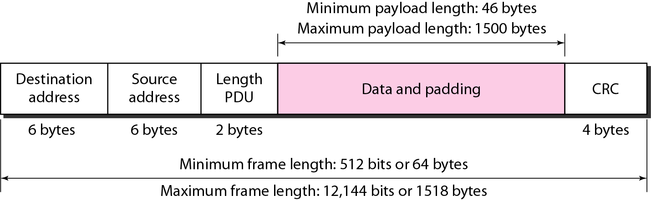
Figure Minimum and maximum lengths

Slide 49
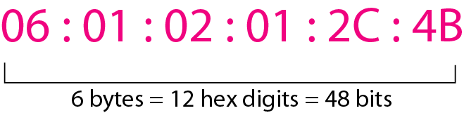
Figure Example of an Ethernet address in hexadecimal notation

Slide 50
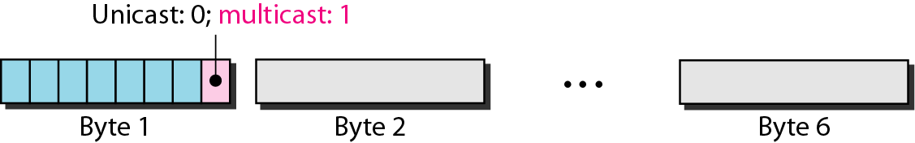
Figure Unicast and multicast addresses
The least significant bit of the first byte defines the type of address.
If the bit is 0, the address is unicast; otherwise, it is multicast.
The broadcast destination address is a special case of the multicast address in which all bits are 1s.

Slide 51
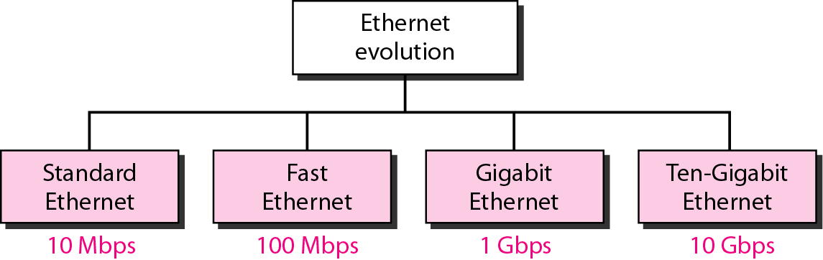
Figure Ethernet evolution through four generations

Slide 52
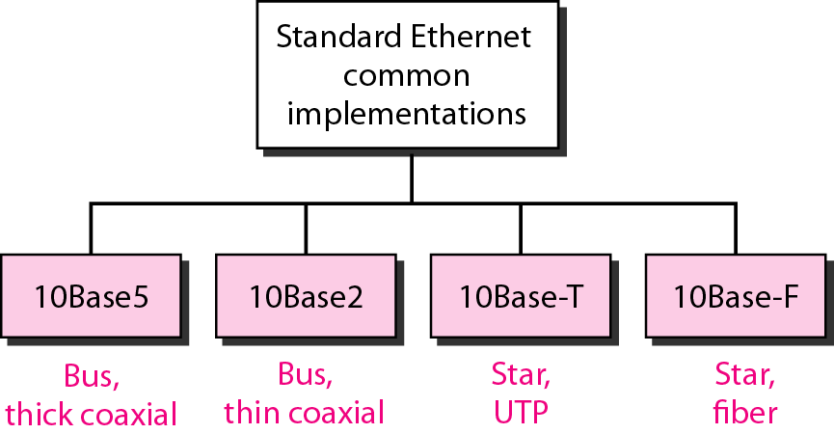
Figure Categories of Standard Ethernet

Slide 53
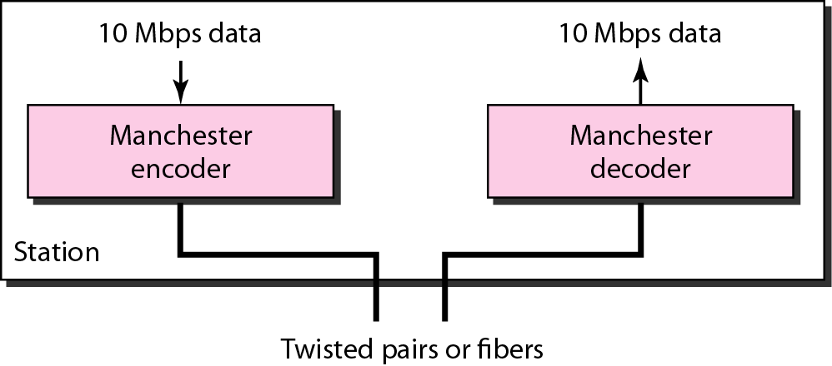
Figure Encoding in a Standard Ethernet implementation

Slide 54
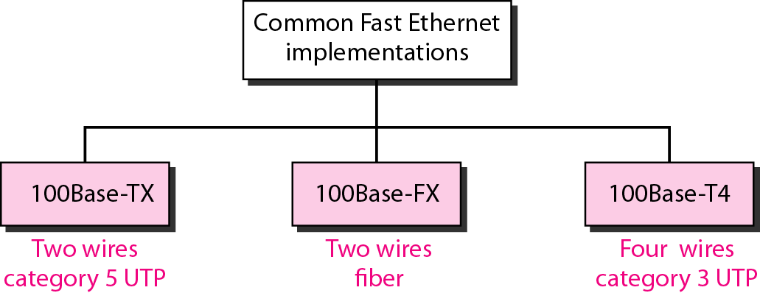
Figure Fast Ethernet implementations

Slide 55
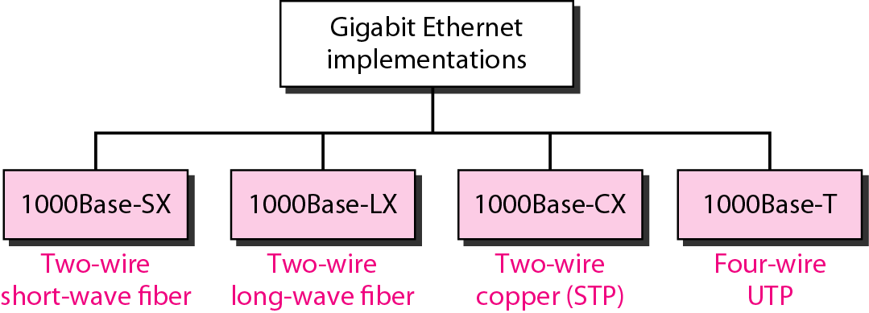
Figure Gigabit Ethernet implementations

Slide 56
Ethernet Evolution
Standard Ethernet
Fast Ethernet
Gigabit Ethernet
Ten-Gigabit Ethernet
10 base 5
10 base 2
10 base-T
10 base-F
100 base-TX
100 base-FX
100 base-T4
1000 base-SX
1000 base-LX
1000 base-CX
1000 base-T
10GBase-S
10GBase-L
10GBase-E

Slide 57
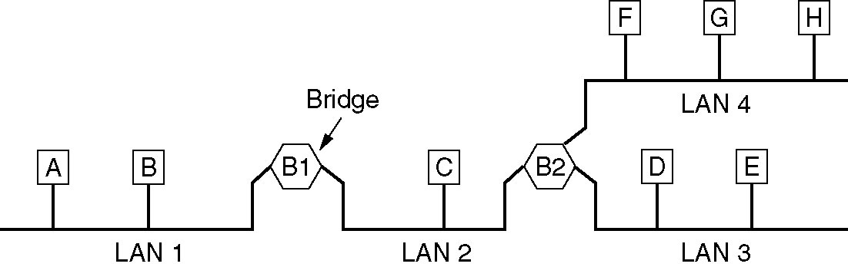
Local Internetworking
A configuration with four LANs and two bridges.

Slide 58
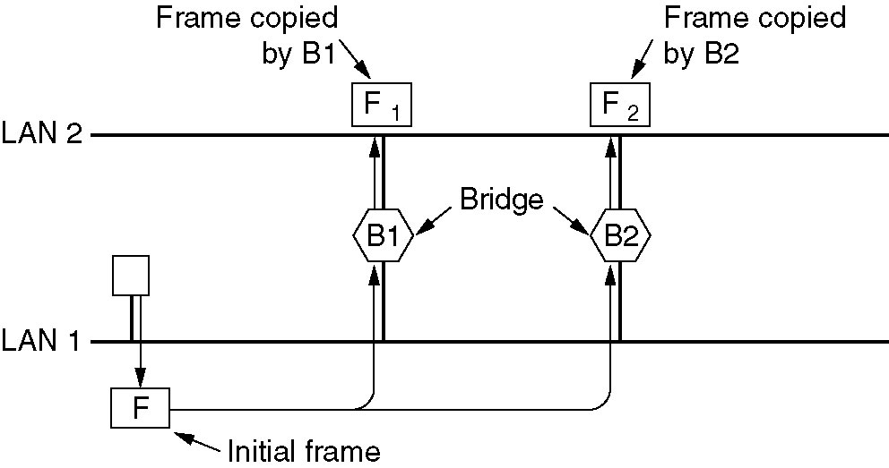
Spanning Tree Bridges
Two parallel transparent bridges.

Slide 59
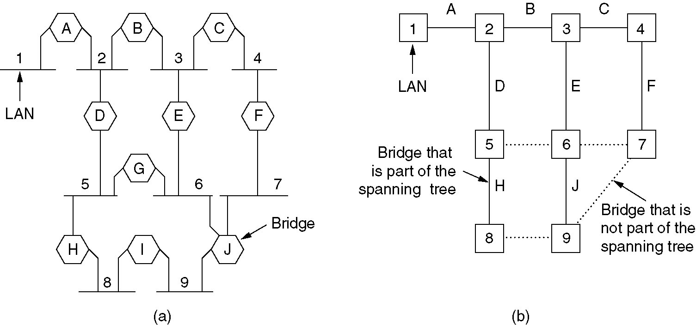
Spanning Tree Bridges (2)
(a) Interconnected LANs. (b) A spanning tree covering the LANs. The dotted lines are not part of the spanning tree.

Slide 60
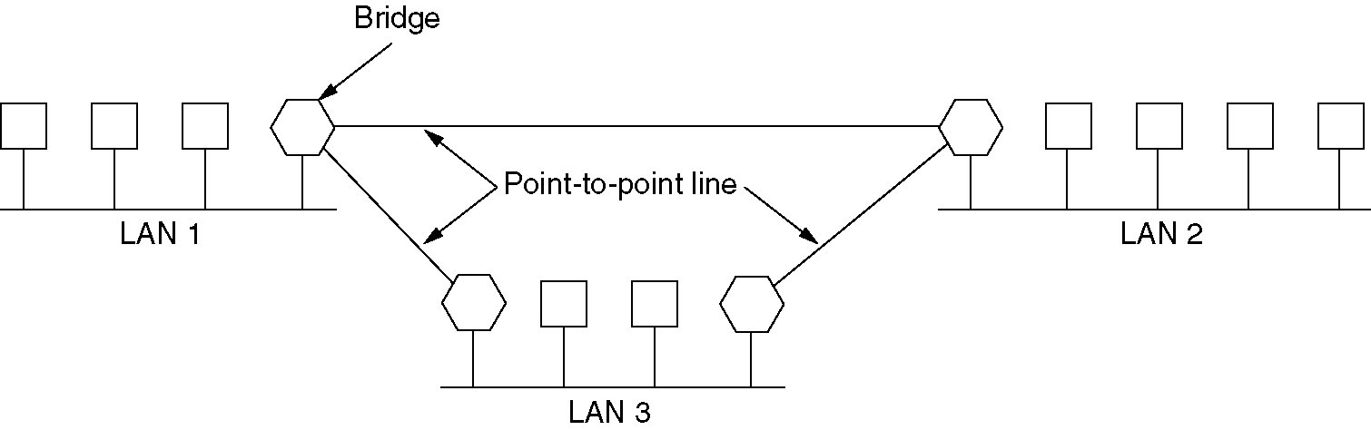
Remote Bridges
Remote bridges can be used to interconnect distant LANs.

Slide 61
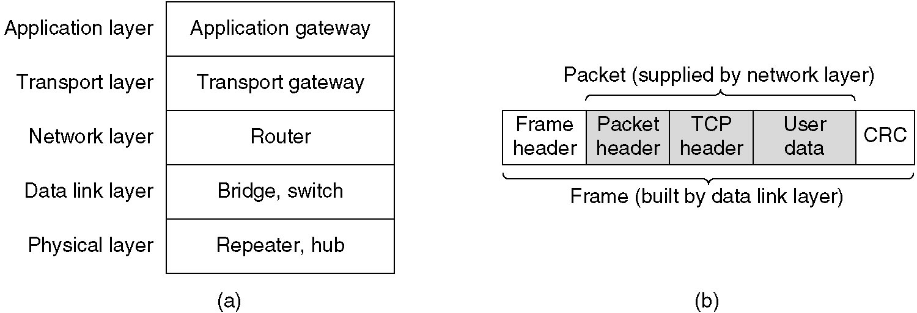
Repeaters, Hubs, Bridges, Switches, Routers and Gateways
(a) Which device is in which layer.
(b) Frames, packets, and headers.

Slide 62
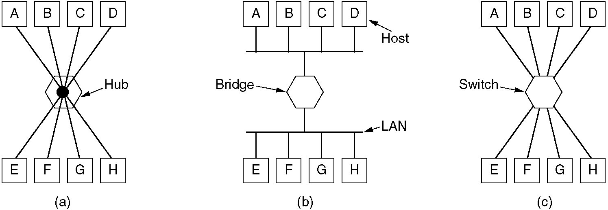
Repeaters, Hubs, Bridges, Switches, Routers and Gateways (2)
(a) A hub. (b) A bridge. (c) a switch.

Slide 63
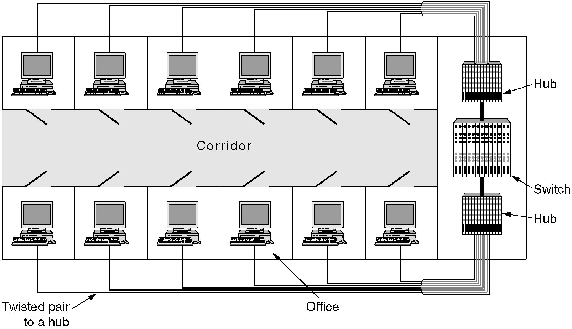
Virtual LANs
A building with centralized wiring using hubs and a switch.

Slide 64
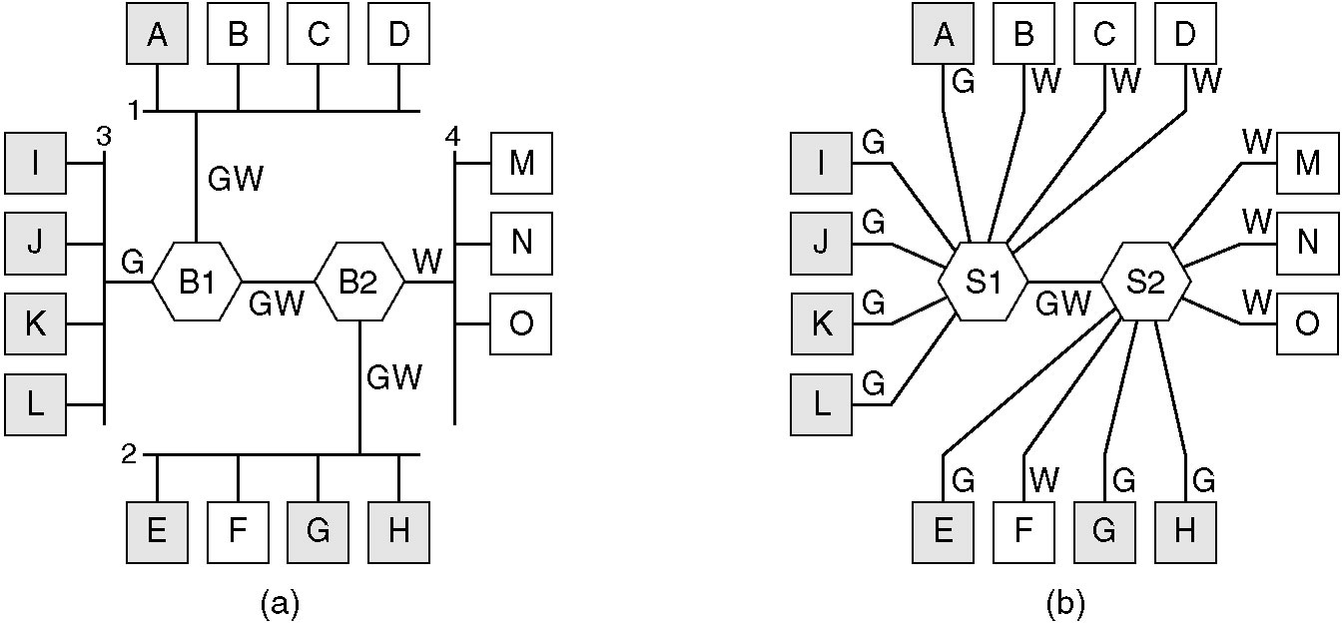
Virtual LANs (2)
(a) Four physical LANs organized into two VLANs, gray and white, by two bridges. (b) The same 15 machines organized into two VLANs by switches.

Slide 65
Thank You

